Slide 1
EDA
1-wire Protocol

Slide 2
Team Members
01
02
Naira Wasseem Ebraheem 23P0373
Sara Mahmoud Ibrahim 23P0172

Slide 3
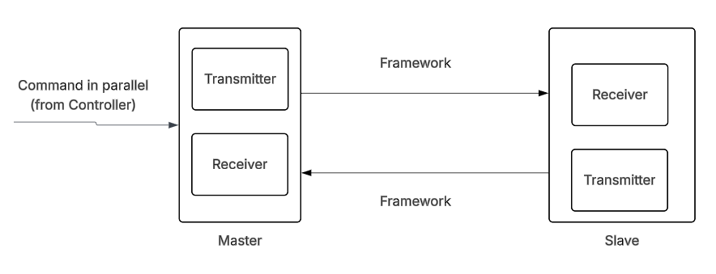
Full System

Slide 4
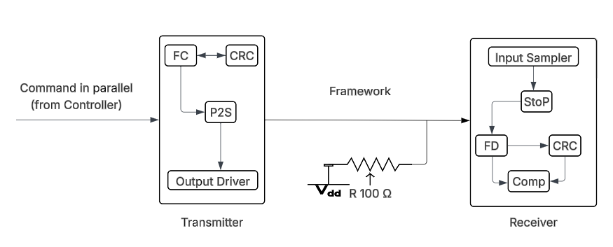
Master-Slave Architecture

Slide 5
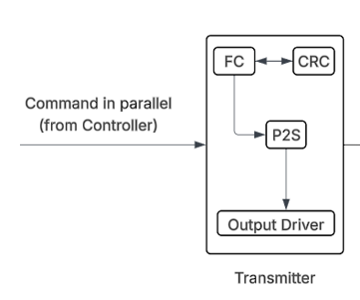
Transmitter Architecture

Slide 6
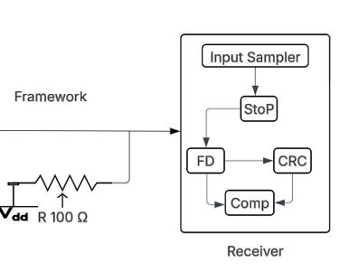
Reciever Architecture

